Slide 1
Pipelined Architecture CSEN 3104 Lecture 10
Dr. Debranjan Sarkar

Slide 2
Minimum Latency
Although the cycle with the minimum average latency maximizes the throughput of the pipeline, sometimes a less efficient cycle may be chosen to reduce the implementation complexity of the pipeline's control circuit (i.e., a trade-off between time and cost)
For example, the cycle C=(1,3,3), which has the MAL of 2.33, requires a circuit that counts one unit of time, then three units, again three units, and so on
However, if it is acceptable to initiate an input datum after every 3 units of time, the complexity of the circuit will be reduced. Therefore, sometimes it may be necessary to determine the smallest latency that can be used for initiating input data at all times
Such a latency is called the minimum latency

Slide 3
Example 1: Minimum Latency
One way to determine the minimum latency is to choose a cycle of length 1 with the smallest latency from the state diagram. In this example, it is 3/1 = 3
Another way is to find the smallest integer whose product with any arbitrary integer is not a member of the forbidden list.
For example, for the forbidden list (2, 5), the minimum latency can be determined as follows:

Slide 4
Example 1: Minimum Latency
Forbidden Latency Set is { 2,5}
Therefore the minimum latency for this pipeline is 3.
Minimum Latency | Times an integer | Product | Result
1 | *1 | =1 | OK
1 | *2 | =2 | No good
2 | *1 | =2 | No good
3 | *1 | =3 | OK
3 | *2 | =6 | OK
4 | *1 | =4 | OK
4 | *2 | =8 | OK

Slide 5
Simple cycle and Greedy cycle
Simple Cycle: latency cycle in which each state is encountered only once.
In this example, the simple cycles are (3),(6), (1,6), (4,6), (4,3), (1,3,3), (1,3,6) and (4)
The cycle (1,3,4,3) is not a simple cycle as the state 10011 is encountered twice
Greedy Cycle: A simple cycle is a greedy cycle whose edges are all made with minimum latencies from their respective starting states
At least one of the greedy cycles will lead to MAL.
In this example, the Greedy cycle is (1,3,3)
In the above example, the cycle that offers MAL is (1, 3, 3)

Slide 6
Upper and Lower Bounds of MAL
Lower bound of MAL = the maximum number of checkmarks in any row of the Reservation Table
MAL > max no. of check marks in any row of the reservation table
In this example, Lower bound of MAL = 2, since there are maximum 2 checkmarks in any row of the RT
Upper bound of MAL= the number of 1's in the initial collision vector plus 1
MAL < avg latency of any greedy cycle
< no. of 1’s in initial collision vector + 1
In this example, ICV is 10010, so number of 1’s = 2
Upper bound of MAL = 2 + 1 = 3
So 2 < MAL < 3

Slide 7
Scheduling of Static Pipelines

Slide 8
Example 2
Output
Input
Stage 1
Stage 2
Stage 3
 | 1 | 2 | 3 | 4 | 5
Stage 1 | X |  |  |  | X
Stage 2 |  | X | X
Stage3 |  |  |  | X
Forbidden Latencies: 1, 4
C₄C₃C₂C₁
Initial Collision Vector: 1 0 0 1

Slide 9
Example 2
1 0 0 1
3, 5+
State Diagram
The following are the average latencies of the different cycles
(2 + 3)/2 =2.5 (2 + 5)/2 =3.5 3/1= 3 5/1= 5
The minimum average latency is 2.5
2
3, 5+
1 0 1 1

Slide 10
Example 2: Minimum Latency
Although the cycle with the minimum average latency maximizes the throughput of the pipeline, sometimes a less efficient cycle may be chosen to reduce the implementation complexity of the pipeline's control circuit (i.e., a trade-off between time and cost)
For example, the cycle C=(2,3), which has the MAL of 2.5, requires a circuit that counts three units of time, then two units, again three units, and so on.
However, if it is acceptable to initiate an input datum after every three units of time, the complexity of the circuit will be reduced. Therefore, sometimes it may be necessary to determine the smallest latency that can be used for initiating input data at all times.
Such a latency is called the minimum latency

Slide 11
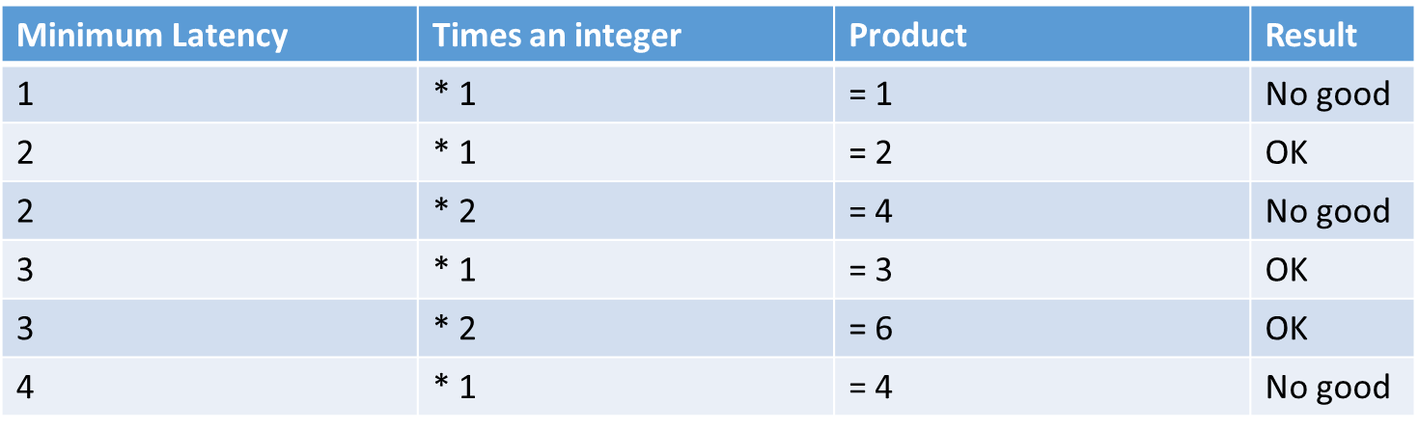
Example 2: Minimum Latency
One way to determine the minimum latency is to choose a cycle of length 1 with the smallest latency from the state diagram
Another way is to find the smallest integer whose product with any arbitrary integer is not a member of the forbidden list.
For example, for the forbidden list (1, 4), the minimum latency can be determined as follows:
Therefore the minimum latency for this pipeline is 3

Slide 12
Example 2: Simple cycle and Greedy cycle
Simple Cycle: latency cycle in which each state is encountered only once.
In Example 2, the simple cycles are (3),(5), (2,3), (2,5)
Greedy Cycle: A simple cycle is a greedy cycle whose edges are all made with minimum latencies from their respective starting states
At least one of the greedy cycles will lead to MAL.
In this example, the Greedy cycle is (2,3)
In the above example, the cycle that offers MAL is (2, 3)

Slide 13
Example 2: Upper and Lower Bounds of MAL
Lower bound of MAL = the maximum number of checkmarks in any row of the Reservation Table
MAL > max no. of check marks in any row of the reservation table
In Example 2, Lower bound of MAL = 2, since there are maximum 2 checkmarks in any row of the RT
Upper bound of MAL= the number of 1's in the initial collision vector plus 1
MAL < avg latency of any greedy cycle
< no. of 1’s in initial collision vector + 1
In example 2, ICV is 1001, so number of 1’s = 2
Upper bound of MAL = 2 + 1 = 3
So 2 < MAL < 3

Slide 14
Example 3
 | 1 | 2 | 3 | 4 | 5 | 6 | 7 | 8
A | X |  |  |  |  | X |  | X
B |  | X |  | X
C |  |  | X |  | X |  | X
Forbidden Latencies:
{5,7,2} ꓴ{2} ꓴ {2,4} = {2,4,5,7}
Sequence for output X: A, B, C, B, C, A, C, A
C₇C₆C₅ C₄C₃C₂C₁
Initial Collision Vector: 1 0 1 1 0 1 0
Output X
Input
A
B
C
Output Y

Slide 15
Example 3: State Diagram for X
8+
1 0 1 1 0 1 0
3
8+
6
8+
1
1 0 1 1 0 1 1
1 1 1 1 1 1 1
3
6

Slide 16
Example 3
Simple Cycles: (3), (6), (8), (1, 8), (3, 8) and (6, 8) are simple cycles
The cycle (6, 8, 1, 8) is not simple because the state (1011010) is encountered twice
Greedy Cycles: The cycle (1, 8) and (3) are greedy cycles
Minimum Average Latency (MAL): In greedy cycles (1, 8) and (3), the cycle (3) leads to MAL value 3

Slide 17
Example 3: Minimum Latency
Minimum Latency | Times an integer | Product | Result
1 | *1 | = 1 | OK
1 | *2 | = 2 | No good
2 | *1 | = 2 | No good
3 | *1 | = 3 | OK
3 | *2 | = 6 | OK
3 | *3 | = 9 | OK
4 | *1 | = 4 | No good
5 | *1 | = 5 | No good
6 | *1 | = 6 | OK
6 | *2 | = 12 | OK
7 | *1 | = 7 | No good
Forbidden Latency Set is { 2, 4, 5, 7}
Therefore the minimum latency for this pipeline is 3.

Slide 18
Example 3: Upper and Lower Bounds of MAL
Lower bound of MAL = the maximum number of checkmarks in any row of the Reservation Table
In this example, Lower bound of MAL = 3, since there are maximum 3 checkmarks in any row of the RT
Upper bound of MAL= the number of 1's in the initial collision vector plus 1
MAL < avg latency of any greedy cycle
< no. of 1’s in initial collision vector + 1
IN this example, ICV is 1011010, so number of 1’s = 4
Upper bound of MAL = 4 + 1 = 5
So 3 < MAL < 5

Slide 19
Assignment
Given the Reservation Table for output Y as follows:
 | 1 | 2 | 3 | 4 | 5 | 6
A | Y |  |  |  | Y
B |  |  | Y
C |  | Y |  | Y |  | Y
(a) Find out the (i) Forbidden latencies and (ii) Initial Collision Vector
(c) Draw the State Diagram for scheduling the pipeline
(d) Find out the simple cycle, greedy cycle and MAL
(e) What are bounds on MAL?

Slide 20
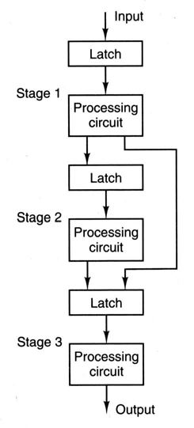
Dynamic Pipeline
A dynamic pipeline can perform more than one operation at a time
This 3-stage dynamic pipeline performs addition and multiplication on different data at the same time
For multiplication, the input data must go through stages 1, 2, and 3
For addition, the data only need to go through stages 1 and 3
In dynamic pipeline, stage 1 can perform the first stage of the addition operation on an input data D1, and at the same time stage 3 can perform the last stage of the multiplication operation on another input data D2
The time interval between the initiation of the inputs D1 and D2 to the pipeline should be such that they do not reach stage 3 at the same time; otherwise, there is a collision
In general, in dynamic pipelines the mechanism that controls when data should be fed to the pipeline is much more complex than in static pipelines

Slide 21
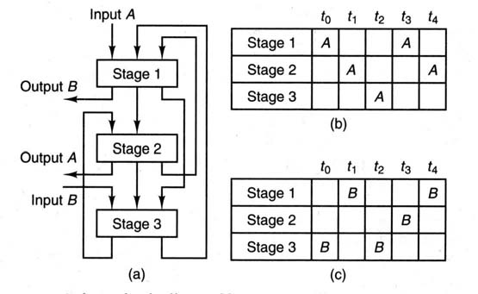
A dynamic pipeline and its reservation tables

Slide 22
A dynamic pipeline and its reservation tables

Slide 23
Example of Overlaid Reservation Table
 | t₀ | t₁ | t₂ | t₃ | t₄
Stage 1 | A |  |  | A
Stage 2 |  | A
Stage 3 |  |  | A |  | A
For A
 | t₀ | t₁ | t₂ | t₃ | t₄
Stage 1 |  | B |  |  | B
Stage 2 |  |  |  | B
Stage 3 | B |  | B
For B
 | t₀ | t₁ | t₂ | t₃ | t₄
Stage 1 | A | B |  | A | B
Stage 2 |  | A |  | B
Stage 3 | B |  | AB |  | A
Overlaid

Slide 24
Scheduling of Dynamic Pipeline
When scheduling a static pipeline, only collisions between different input data for a particular function had to be avoided.
With a dynamic pipeline, it is possible for different input data requiring different functions to be present in the pipeline at the same time.
Therefore, collisions between these data must be considered as well.
As with the static pipeline, however, dynamic pipeline scheduling begins with the compilation of a set of forbidden lists from function reservation tables.
Next the collision vectors are obtained, and finally the state diagram is drawn.

Slide 25
Forbidden Lists of Dynamic Pipeline
With a dynamic pipeline, in general there are p² forbidden lists and hence p² cross-collision vectors for a p-function pipeline
In the earlier figure, there are 2 functions (A and B), so the number of forbidden lists is 4, denoted by AA, AB, BA, and BB
Task A may collide with a previously initiated task B, if the latency between these two initiations is a member of the forbidden list
AA = (2,3), AB = (1,2,4), BA = (2,4), and BB = (2,3),

Slide 26
Collision Vectors and Collision matrices
The collision vectors are determined in the same manner as for a static pipeline
0 indicates a permissible latency and a 1 indicates a forbidden latency
For the preceding example, the collision vectors are
C_{AA} = (0 1 1 0), C_{BA} = (1 0 1 0), C_{AB} = (1 0 1 1), C_{BB} = (0 1 1 0)
The collision vectors for the A function form the collision matrix M_{A},
that is, M_{A} = [C_{AA}, C_{BA}]^{T}
The collision vectors for the B function form the collision matrix M_{B}:
that is, M_{B} = [C_{AB}, C_{BB}]^{T}
For the above collision vectors, the collision matrices are
M_{A} = [0110, 1010]^{T} M_{B} = [1011, 0110]^{T}

Slide 27
State Diagram
The state diagram for the dynamic pipeline is developed in the same way as for the static pipeline
The resulting state diagram is much more complicated than a static pipeline state diagram due to the larger number of potential collisions

Slide 28
Problems of pipeline
In practice, making the delays of pipeline stages equal is a complicated and time-consuming process
It is essential to maximize performance that the stages be close to balanced.
It is done for commercial processors, although it is not easy and cheap to do
Another problem with pipelines is the overhead in term of handling exception or interrupts
A deep pipeline increases the interrupt handling overhead.

Slide 29
What is Microprocessor without Interlocked Pipelined Stages?
One of the main disadvantages of pipelining is that there can be various dependencies that occur between stages:
Data hazards (RaW, WaW and WaR)
Control Hazards
Structural Hazards
In an interlocked pipeline, hardware is used to check for hazards between stages. Sometimes this may lead to deadlock.
In a non interlocked pipeline, no hardware is used to check for hazards. However, the burden of checking for dependencies is left to the programmer/compiler. If they fail to check for hazards, the program might use invalid data and even create a deadlock requiring a reboot.
MIPS CPU was originally intended to simplify processor design by eliminating hardware interlocks between the five pipeline stages
Later versions of the MIPS ISA did have interlocking however.

Slide 30
Thank you

